Slide 1
Enrollment Management Strategic Plan
Key Performance Indicators:
Current Trends and Progress on Indicators
Fall 2021
INDIANA UNIVERSITY–PURDUE UNIVERSITY INDIANAPOLIS

Slide 2
Purpose of Presentation
Enrollment Management key performance indicators presented in an effort to measure the quality of IUPUI’s performance and assist in developing performance goals and strategies:
Provide data update on all components of IUPUI’s Enrollment Management Key Performance Indicators: Current Trends and Progress on Indicators
Determine the conclusions which should be drawn from the data as a basis for subsequent action discussions

Slide 3
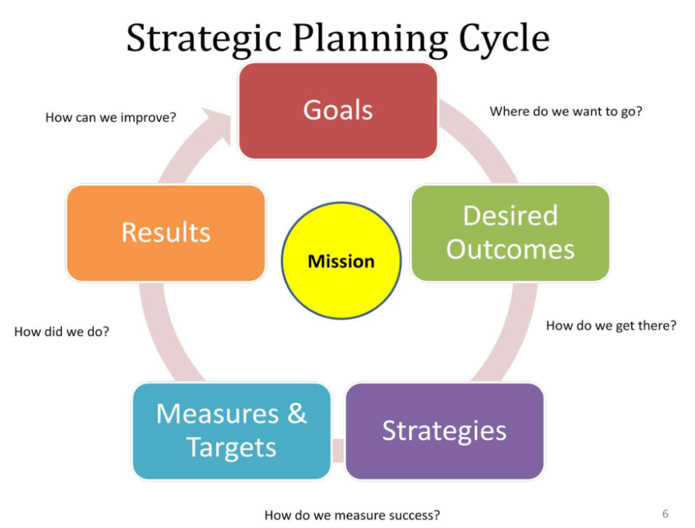
Key Performance Indicators and the Strategic Planning Process
Reflect various components of the institution’s strategic goals and are essentially what will be used to monitor the institution’s progress and determine its success.
The appropriateness of each measure is commonly determined by a committee and may depend largely on what data are already available.
Goals and strategies articulate how the institution will achieve its vision and measures of performance will provide an indication of the progress the institution is making towards reaching those goals.
KPIs measure the quality of an organization’s performance and assist in developing performance goals and strategies.
  Adapted from adapted from Hanover University Press, 2010, www.hanoverresearch.com Key Performance Indicators for Administrative Support Units

Slide 4
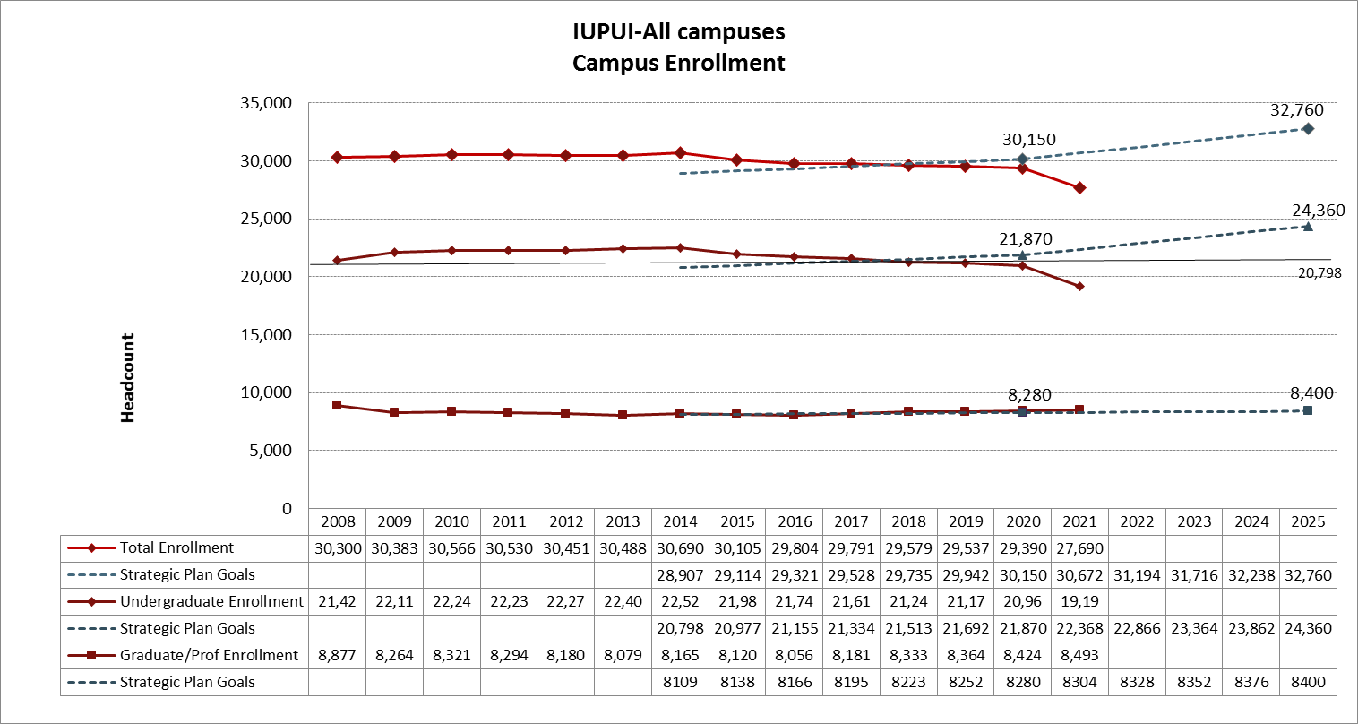
Heads and Credit Metrics
* Includes degree seeking and non-degree students

Slide 5
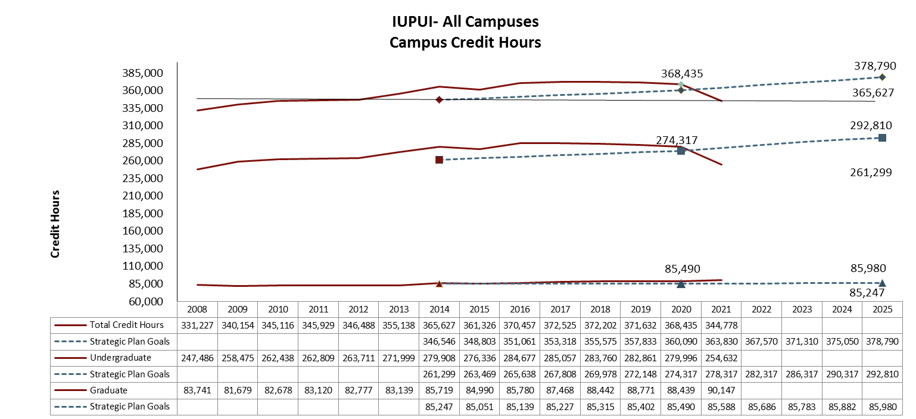
Heads and Credit Metrics
* Includes degree seeking and non-degree students

Slide 6
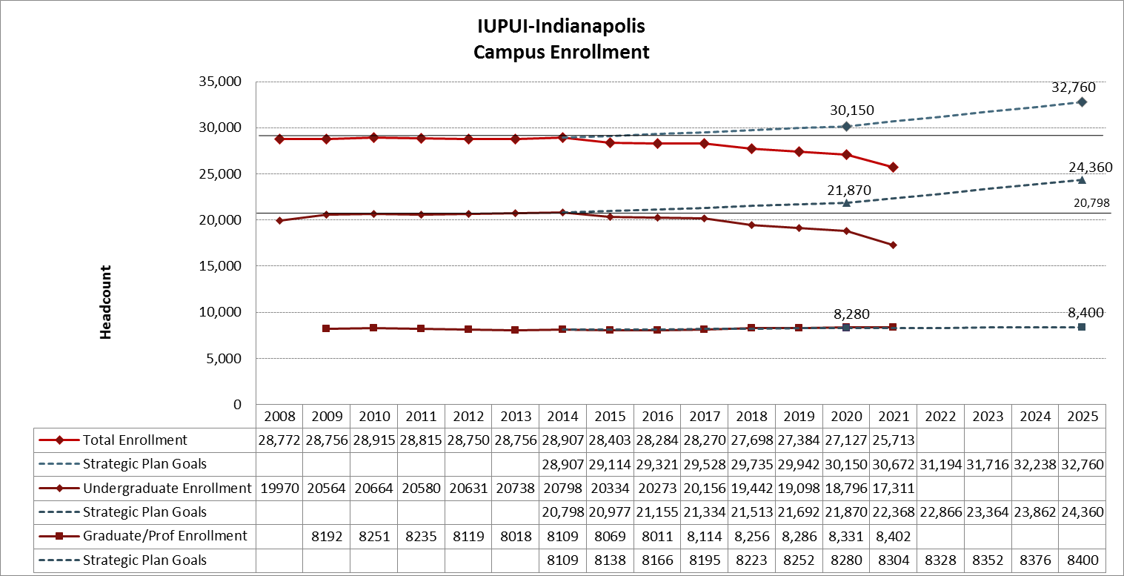
Heads and Credit Metrics
* Includes degree seeking and non-degree students

Slide 7
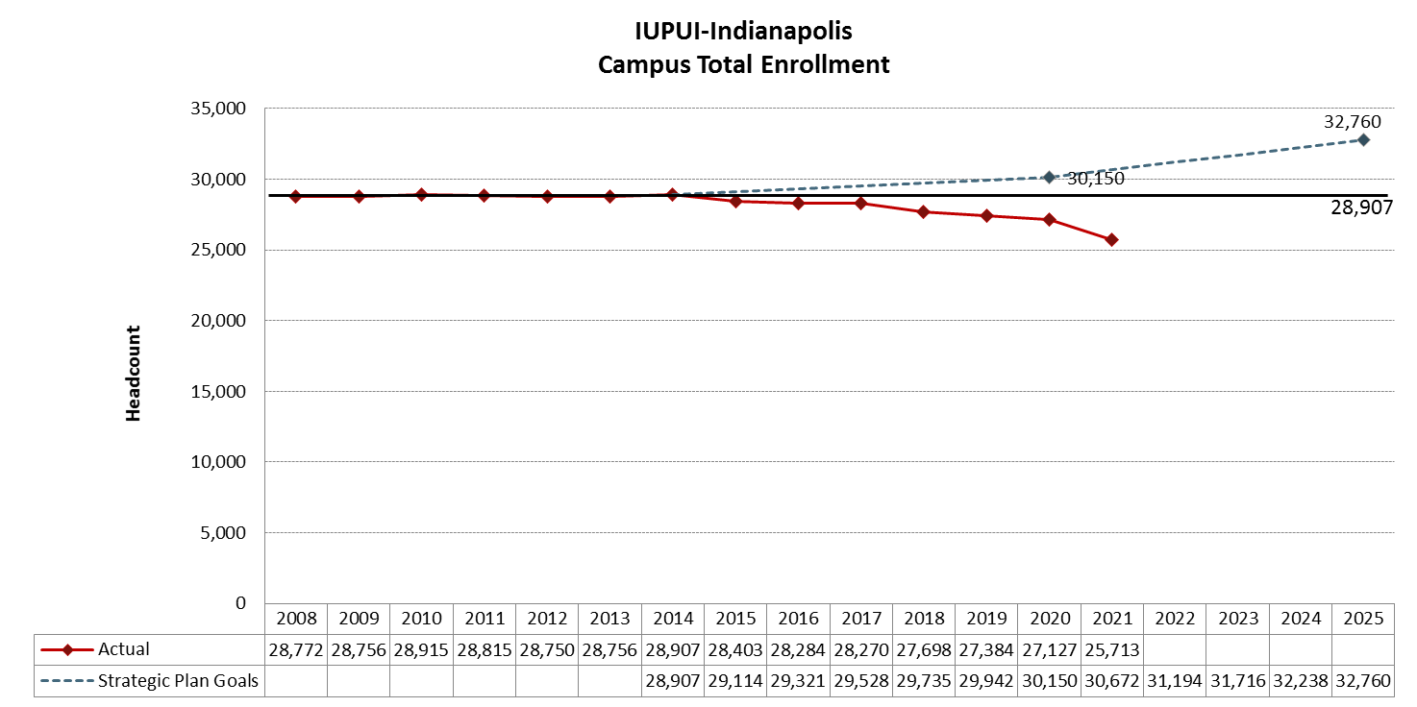
Heads and Credit Metrics
* Includes degree seeking and non-degree students

Slide 8
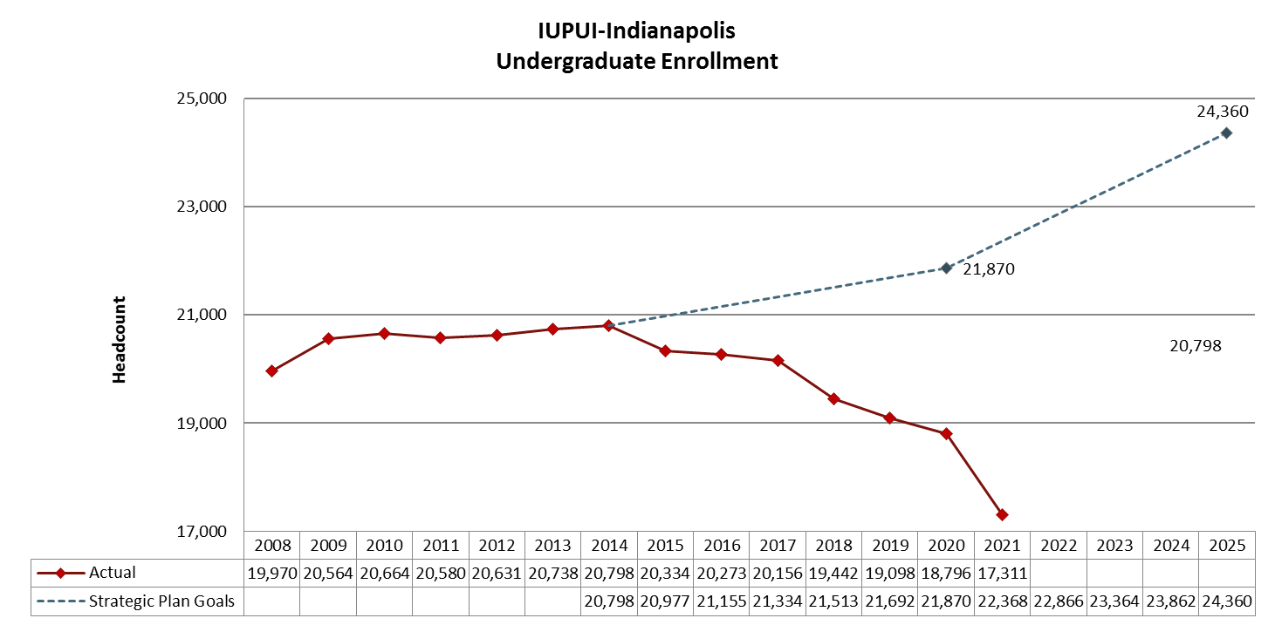
Heads and Credit Metrics
* Includes degree seeking and non-degree students
Office of Institutional Research and Decision Support

Slide 9
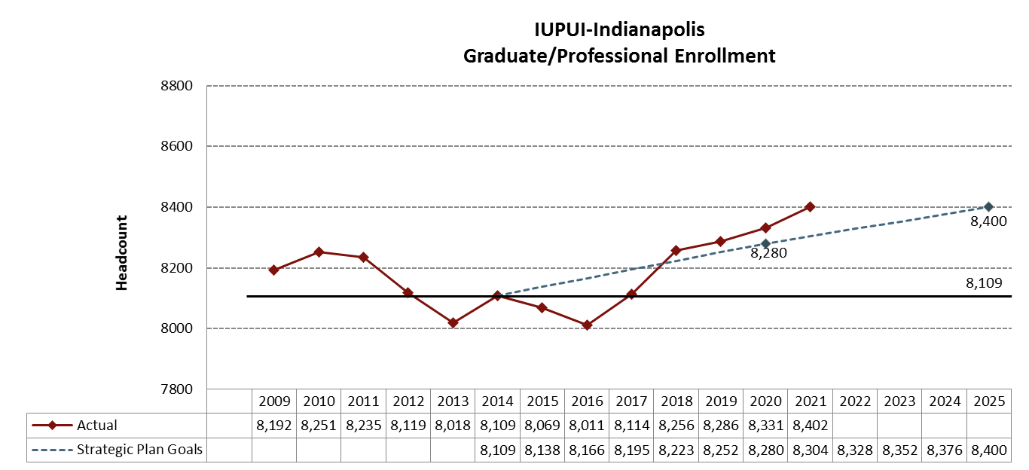
Heads and Credit Metrics
* Includes degree seeking and non-degree students

Slide 10
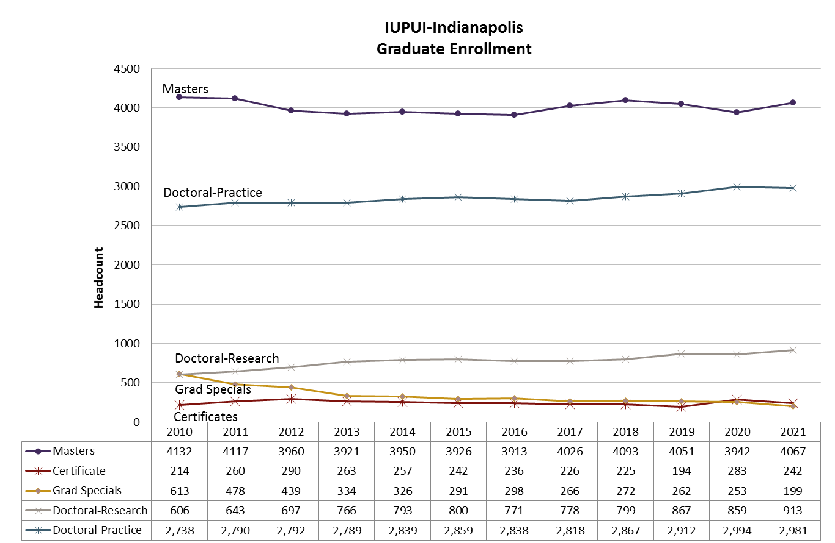
Heads and Credit Metrics

Slide 11
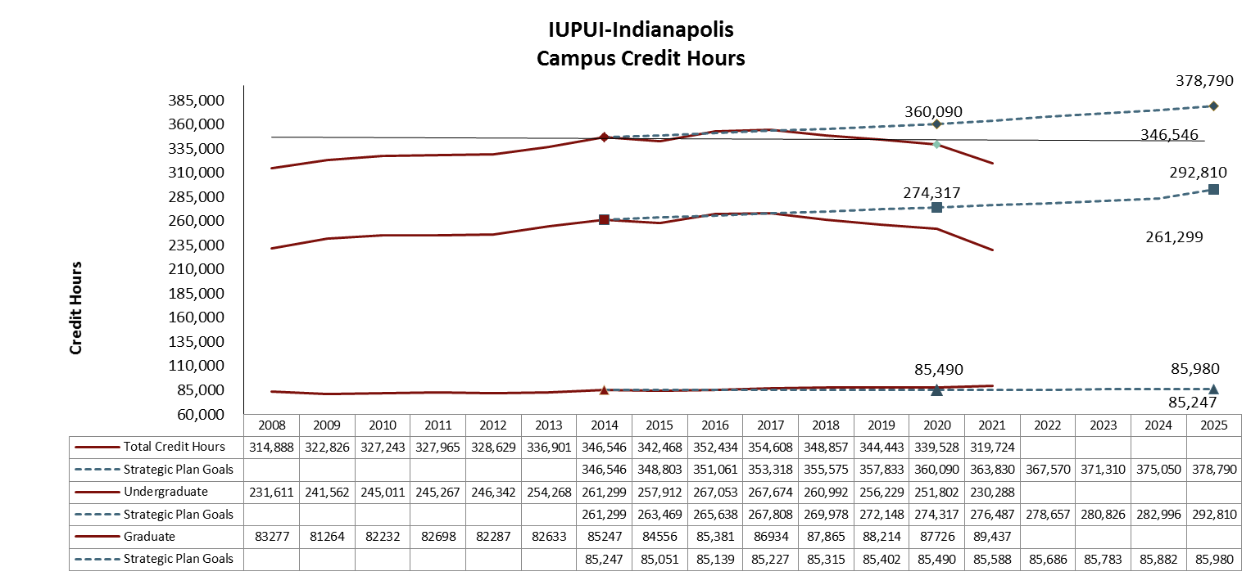
Heads and Credit Metrics
Total Enrollment
Undergraduate Enrollment
Graduate/Professional Enrollment

Slide 12
Heads and Credit Metrics
* Includes degree seeking and non-degree students

Slide 13
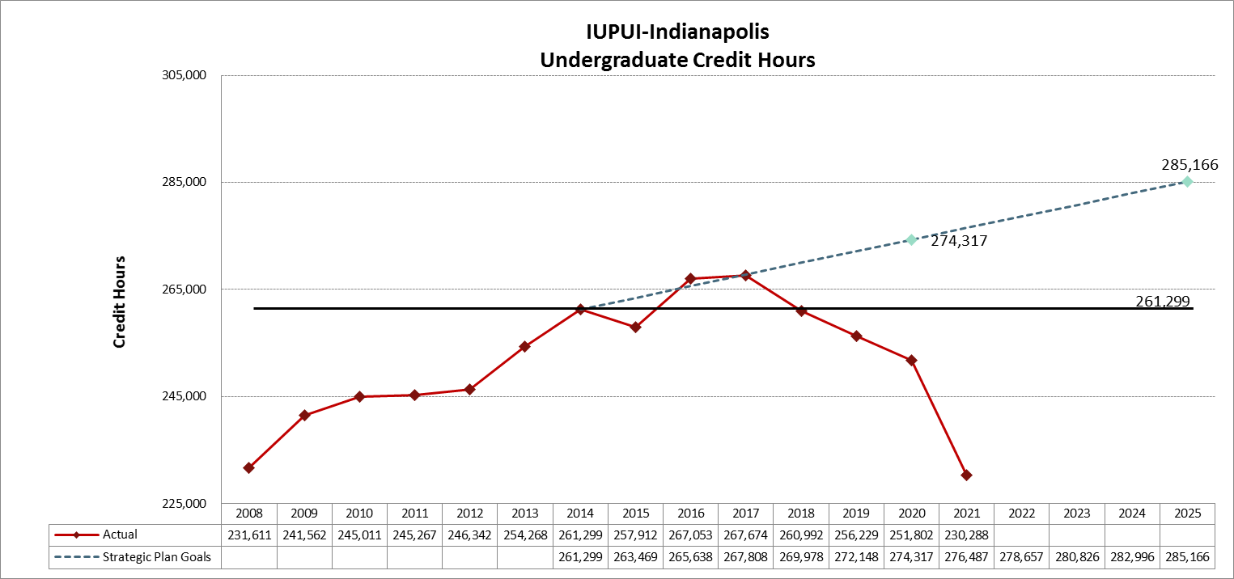
Heads and Credit Metrics
* Includes degree seeking and non-degree students

Slide 14
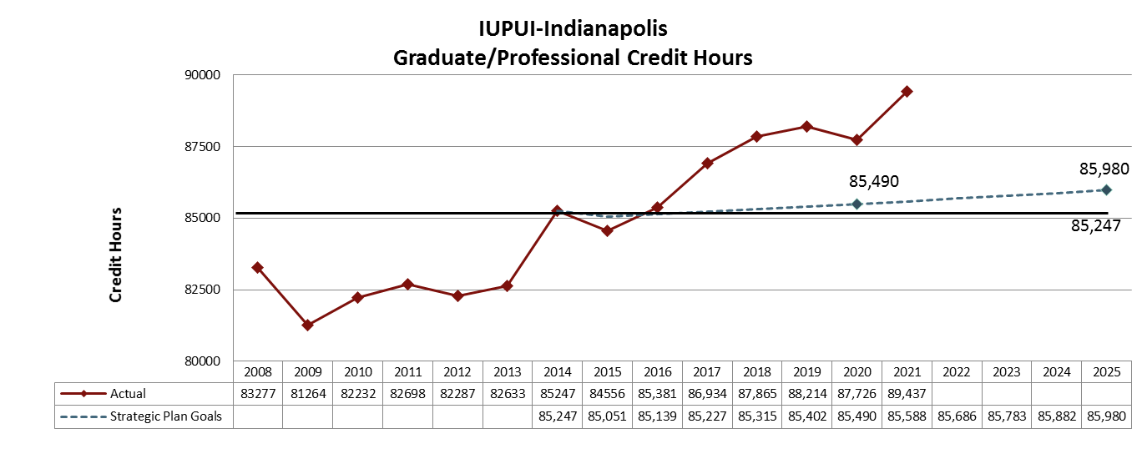
Heads and Credit Metrics
* Includes degree seeking and non-degree students

Slide 15
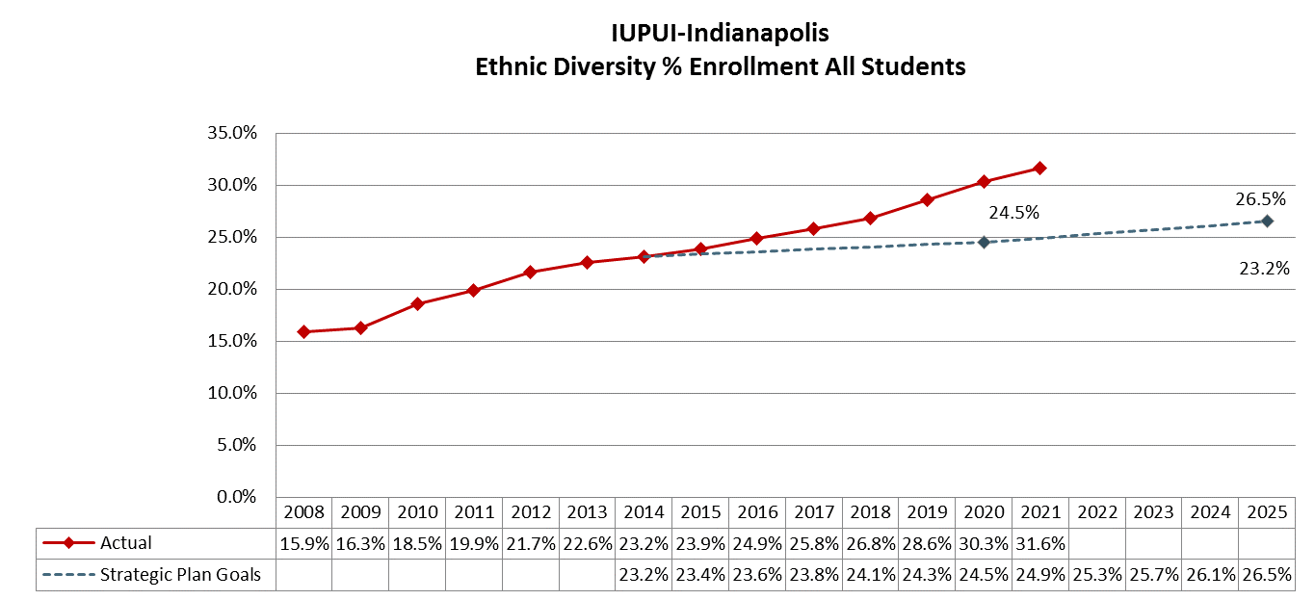
Total Enrollment Metrics
By Ethnic Diversity
Includes U.S. Students of Color categories: African American, American Indian, Asian, Hispanic/Latinx, Pacific Islander, Two or More Races. International students are excluded.

Slide 16
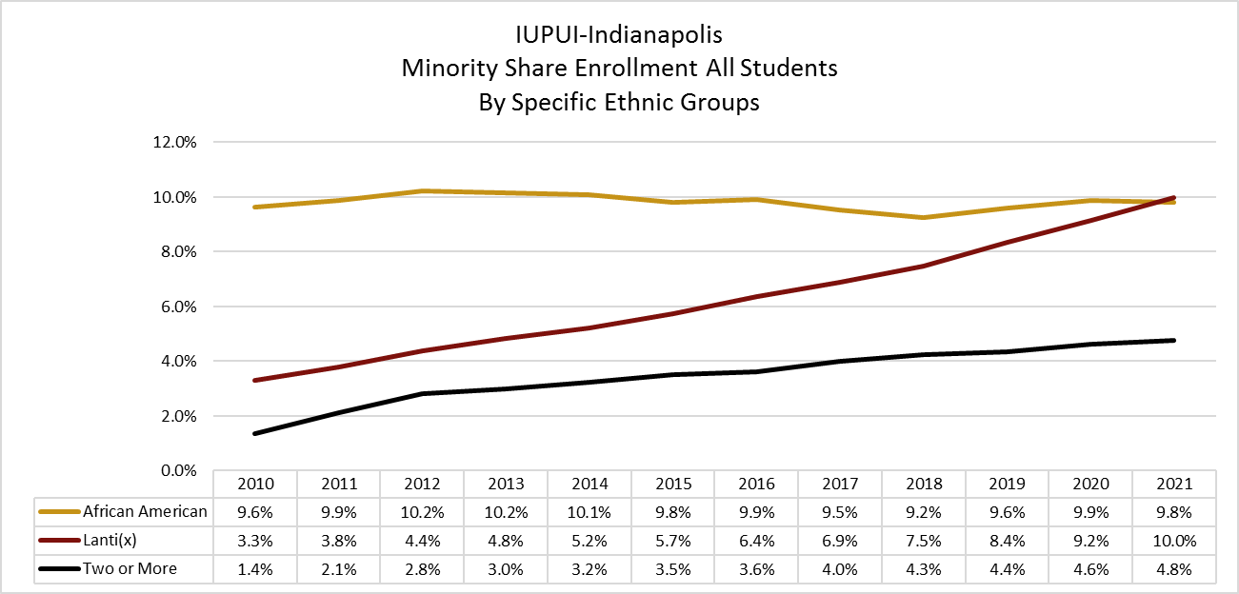
Total Enrollment Metrics
By Ethnic Diversity
Note: In 2010 there was a change it the Ethnicity/Race Definition as applied by the federal government

Slide 17
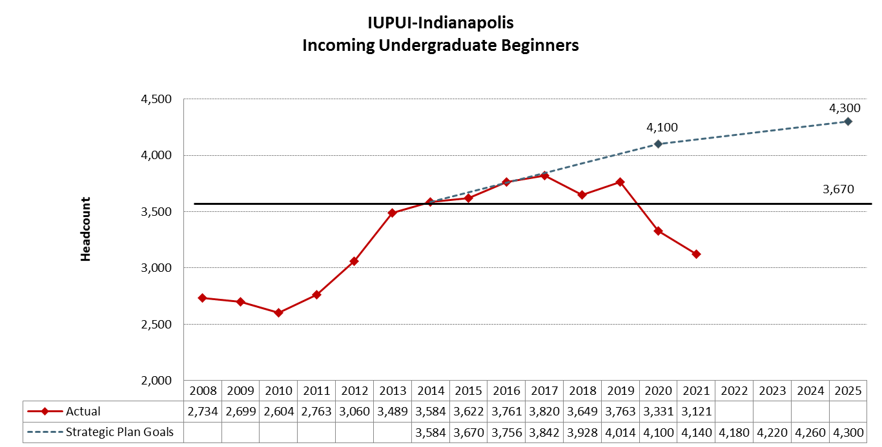
Entering Student Metrics
Beginner Enrollment

Slide 18
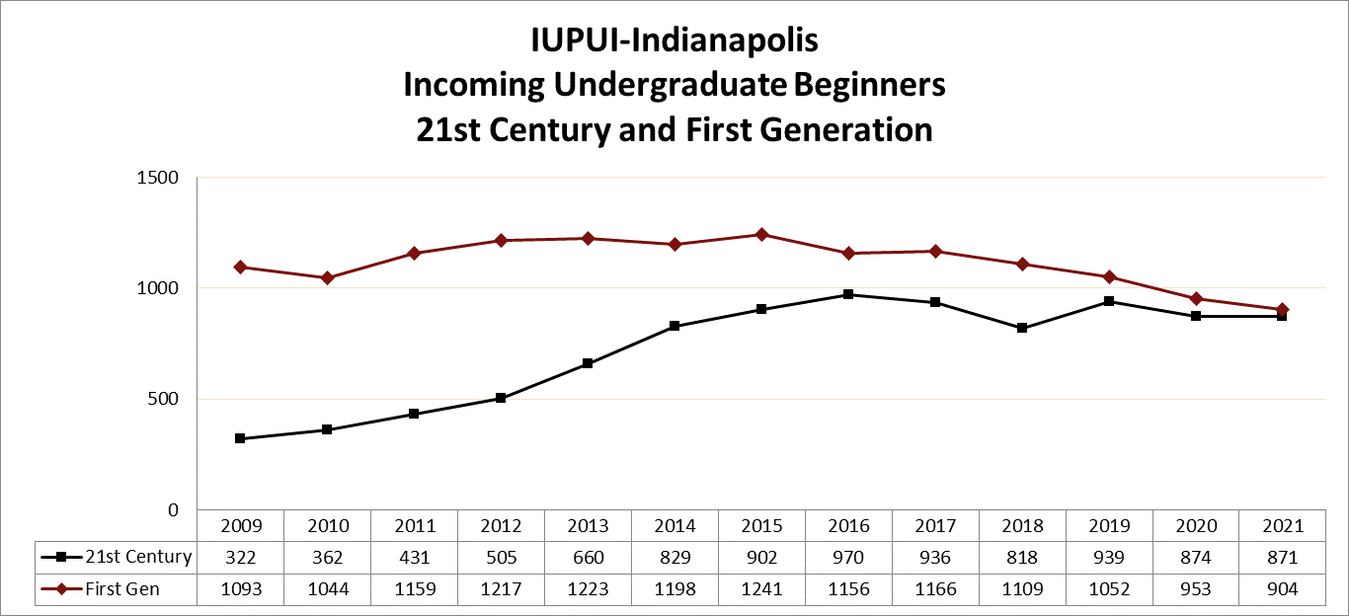
Entering Student Metrics
Beginner Enrollment

Slide 19
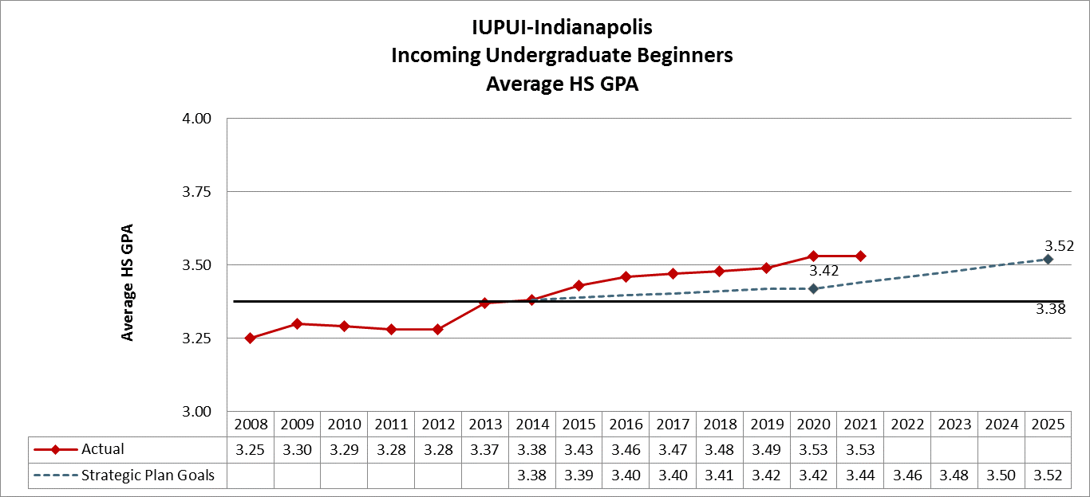
Entering Student Metrics
Beginner Enrollment

Slide 20
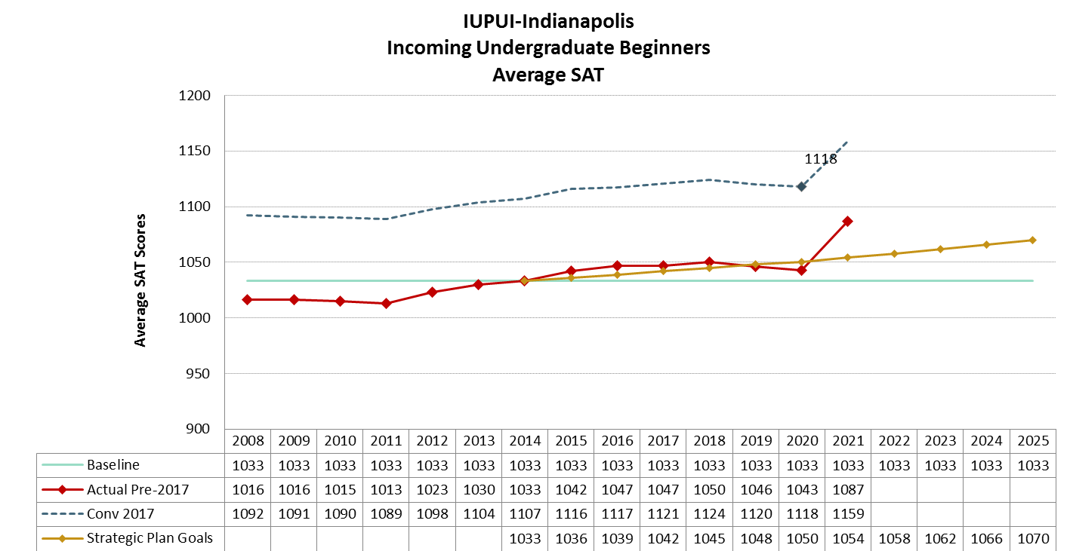
Entering Student Metrics
Beginner Enrollment
* In 2020 due to Covid, Test Optional was implemented ahead of schedule. Full Test Optional began in 2021

Slide 21
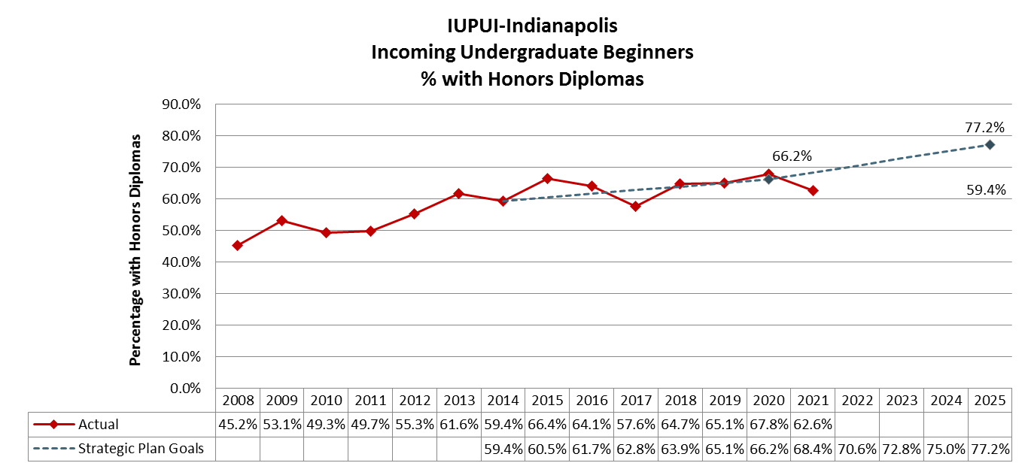
Entering Student Metrics
Beginner Enrollment
% on ALL incoming undergraduate Beginners not just Indiana. A similar pattern is seen regardless of Residency Status.

Slide 22
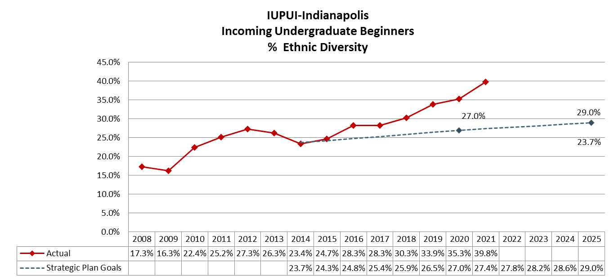
Entering Student Metrics
Beginner Enrollment
Includes U.S. students of color categories: African American, American Indian, Asian, Hispanic/Latino(a), Pacific Islander, Two or More Races. International students are excluded.
Note: In 2010 there was a change it the Ethnicity/Race Definition as applied by the federal government

Slide 23
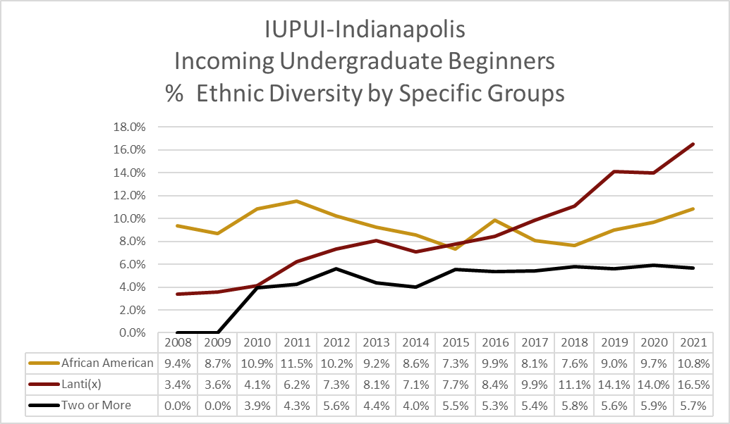
Entering Student Metrics
Beginner Enrollment
Note: In 2010 there was a change it the Ethnicity/Race Definition as applied by the federal government

Slide 24
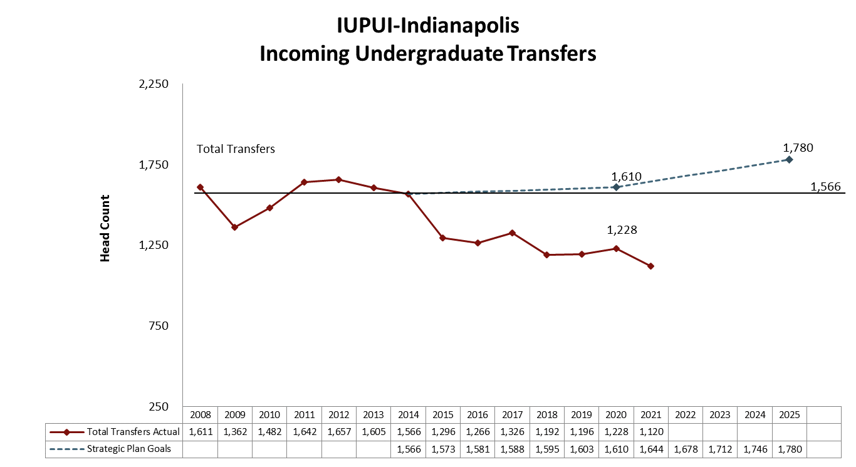
Entering Student Metrics
Transfer Enrollment
Profiles the makeup of our Incoming Transfer Cohort - does not include Intercampus Transfers (ICT)

Slide 25
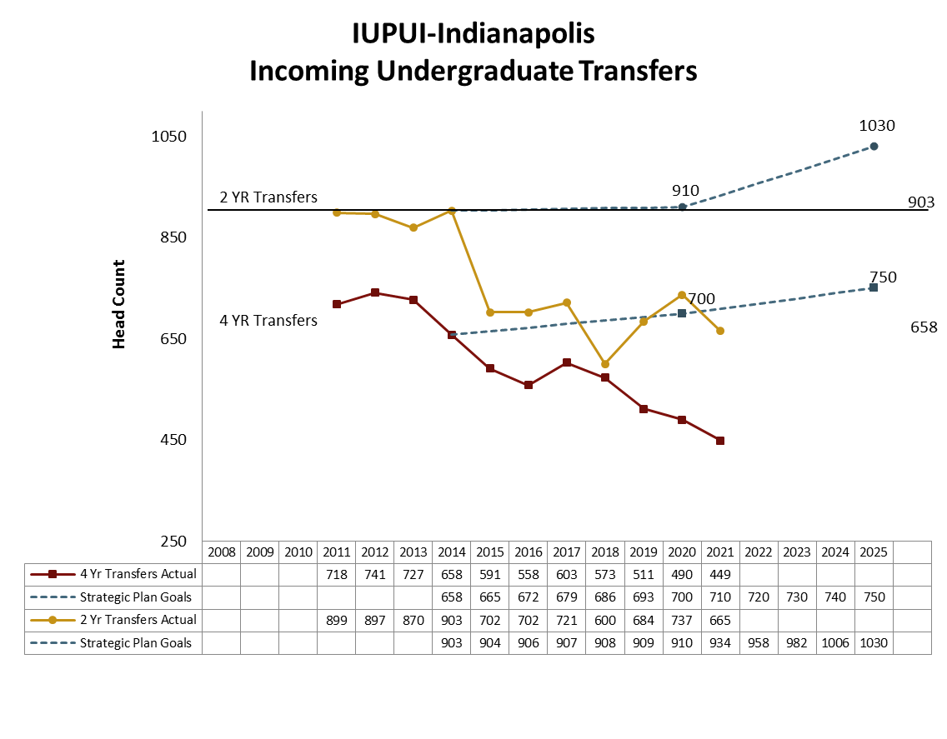
Entering Student Metrics
Transfer Enrollment
Profiles that makeup our Incoming Transfer Cohort - does not include Intercampus Transfers (ICT)

Slide 26
Incoming Undergraduate Transfers
% Ethnic Diversity
Profiles that makeup our Incoming Transfer Cohort - does not include Intercampus Transfers (ICT)

Slide 27
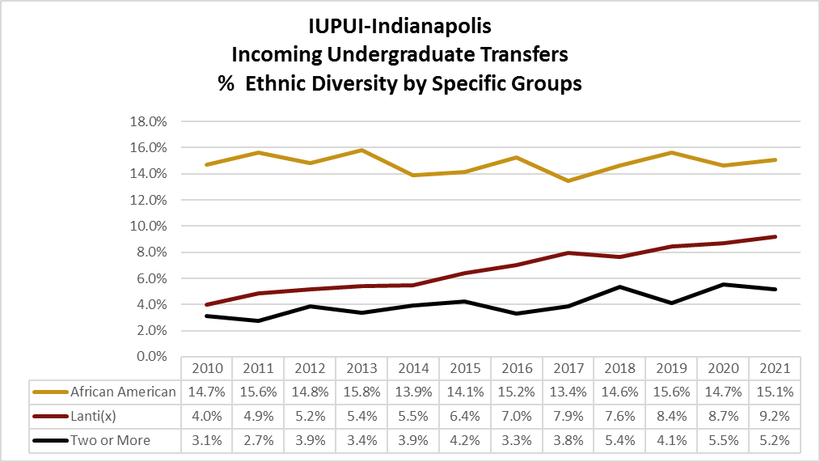
Incoming Undergraduate Transfers
% Ethnic Diversity by Specific Groups
Profiles the makeup of our Incoming Transfer Cohort - does not include Intercampus Transfers (ICT)

Slide 28
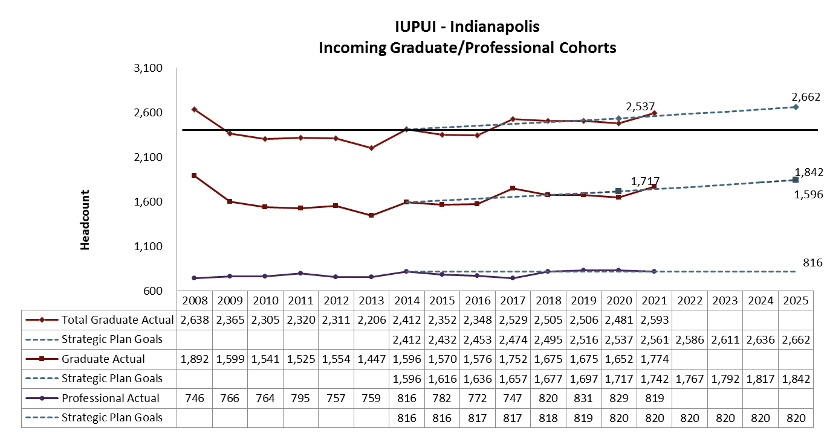
Entering Student Metrics
Graduate Enrollment

Slide 29
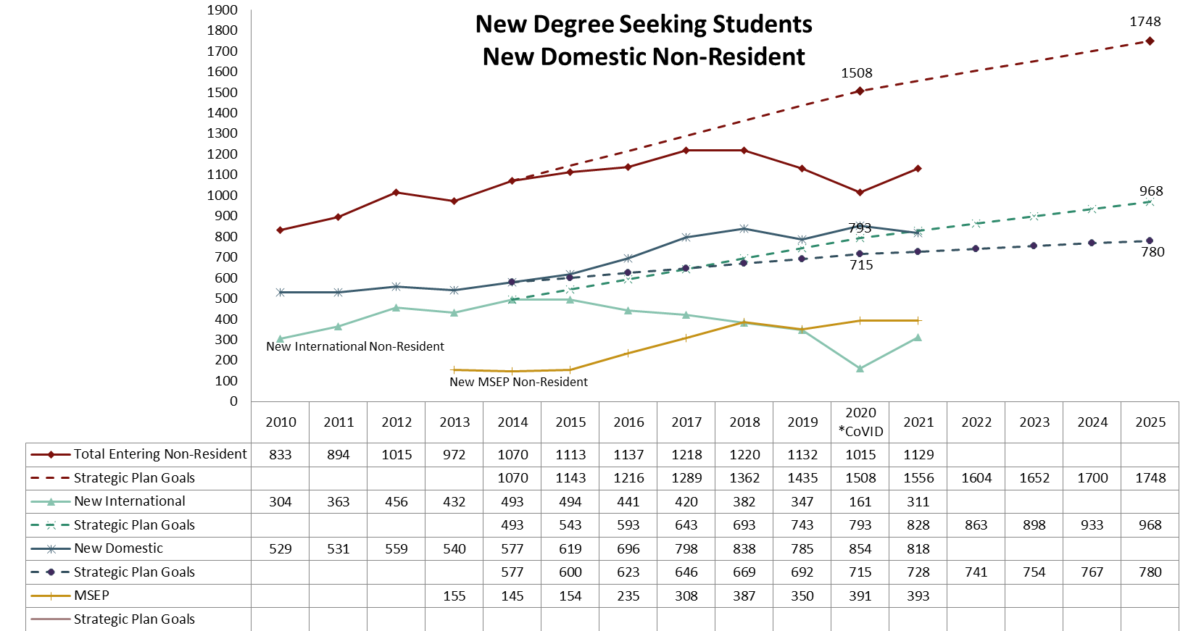
Entering Student Metrics
Non-Resident Enrollment

Slide 30
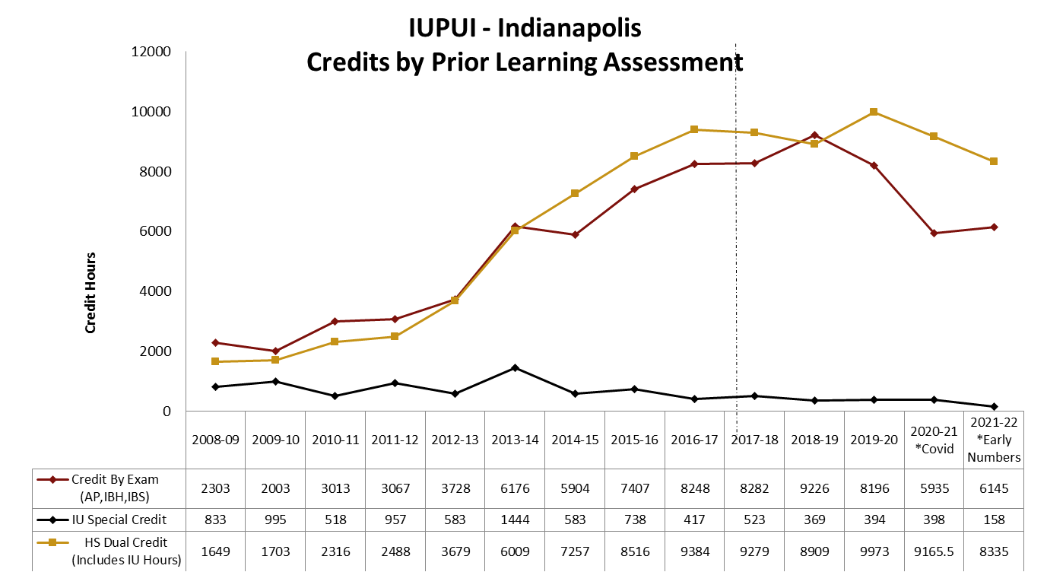
Entering Student Metrics
Credits Awarded Through PLA
Credit by Exam includes credits awarded via the following exams: Advance Placement (AP), International Baccalaureate Honors (IBH), International Baccalaureate Standard (IBS)
IU Special Credit are course credits awarded by IU though a variety of means including: Test, Work, Life Experience, Other
The sharp increase in IU Special Credits during AY 13-14 is due to 25 transfer students being awarded Life Experience Nursing credits
HS Dual Credit is College credit awarded by institutions of Higher Education – including Indiana University (ACP/DCP/SPAN)

Slide 31
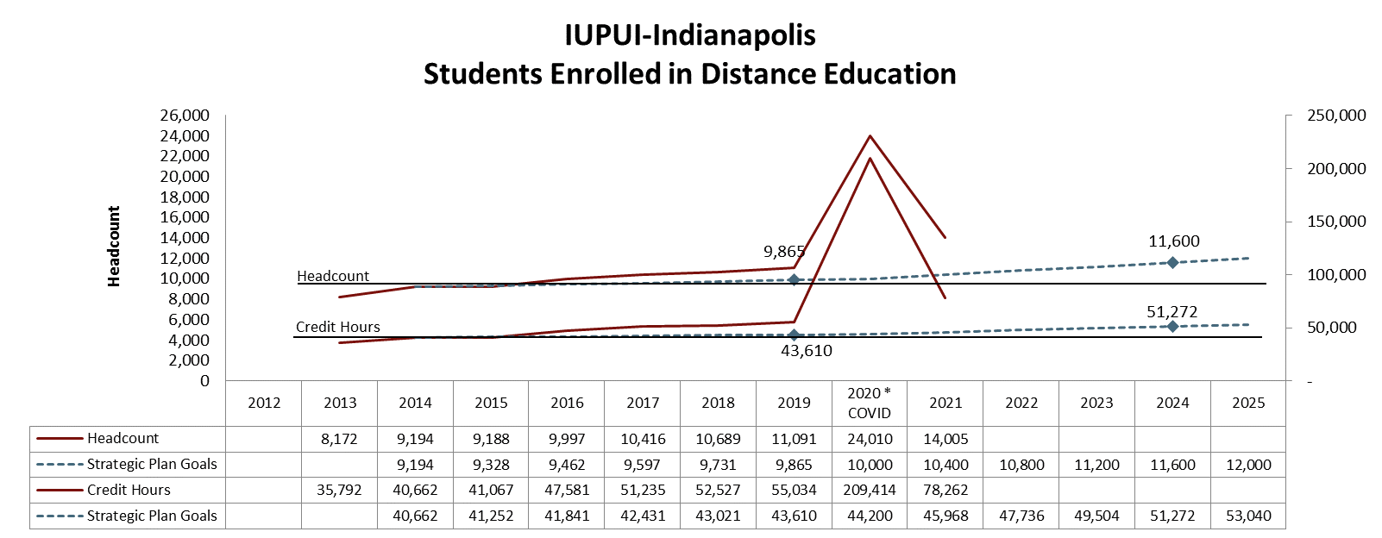
Total Enrollment Metrics
Online Education
Distance Education includes students enrolled in classes that have an instruction mode of “Online-All – 100% Online” or “Online Interactive – 76% - 99% Online”

Slide 32
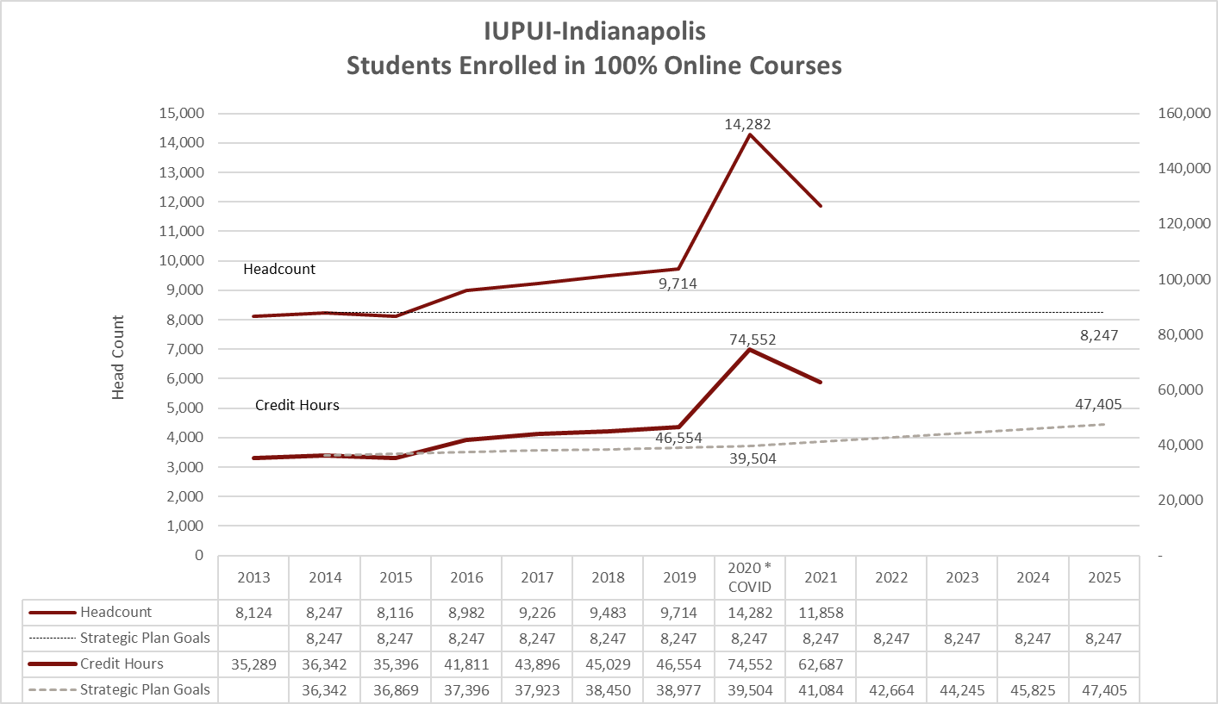
Total Enrollment Metrics
Online Education
Distance Education includes students enrolled in classes that have an instruction mode of “Online-All – 100% Online”

Slide 33
Total Enrollment Metrics
Veterans
* This data represents counts of students identified as Veterans in UIRR enrollment files (IR_CEN_TRM_SNPSHT_GT). This method differs from previous attempts to quantify Veteran students. Data is available beginning in 2014.

Slide 34
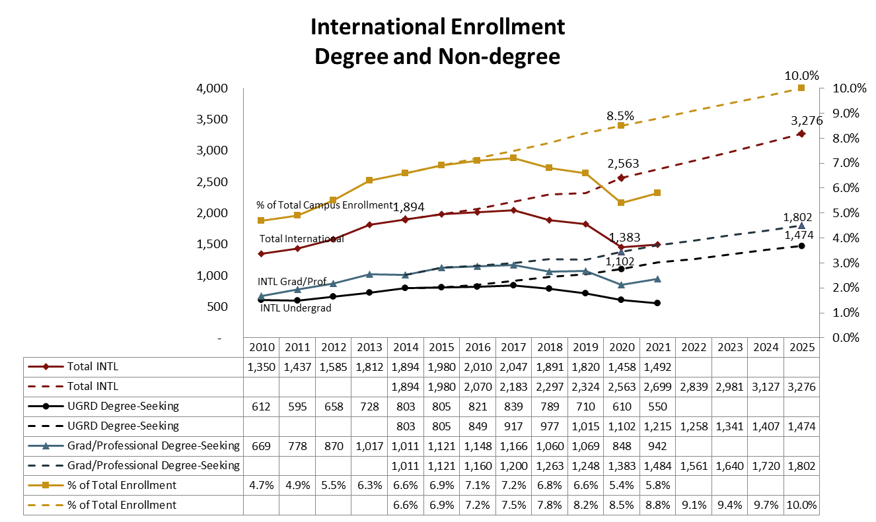
Total Enrollment Metrics
International Students

Slide 35
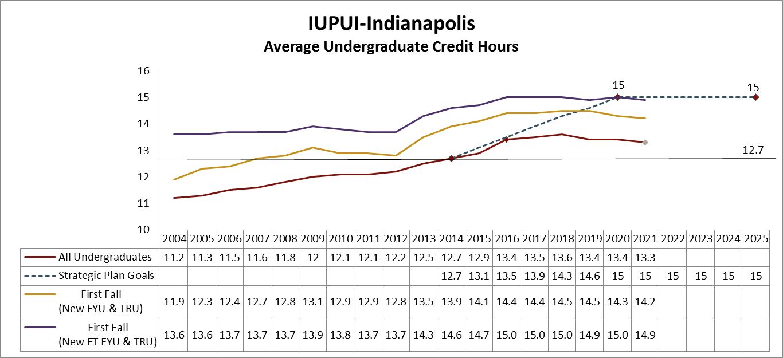
Student Performance Metrics
Average Undergraduate Hours

Slide 36
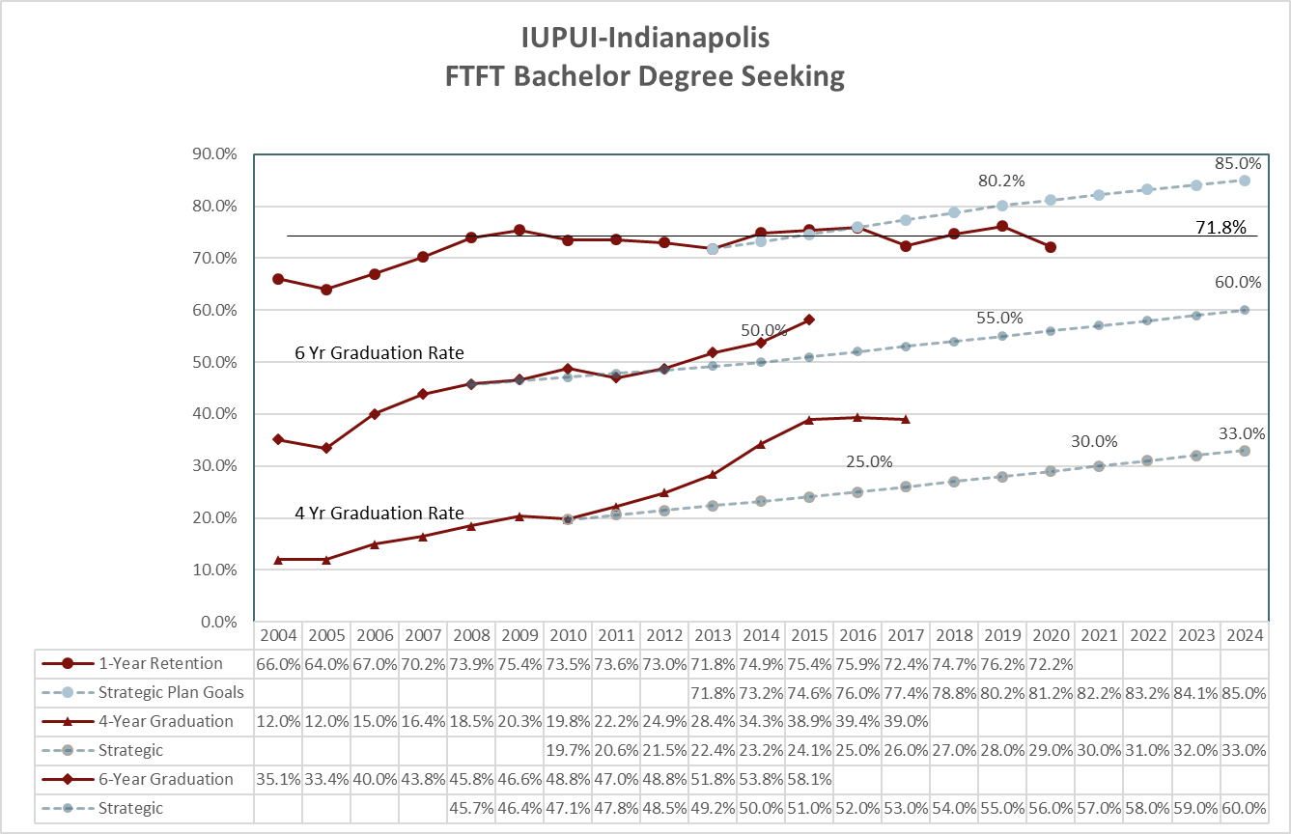
Student Performance Metrics
Retention/Graduation Rates

Slide 37

How do we compare?

Slide 38
Official Peer Institutions:
First-Time Full-Time Beginners - Bachelor’s Degree -
Peer Institutions | One-Year Retention | Four-Year Graduation | Six-Year Graduation
University of Utah | 89% | 34% | 67%
University of Cincinnati -Main Campus | 88% | 37% | 72%
University of Colorado-Denver | 73% | 21% | 44%
Virginia Commonwealth University | 83% | 44% | 66%
University of Illinois at Chicago | 82% | 37% | 63%
Wayne State University | 82% | 24% | 52%
Georgia State Universtiy | 81% | 29% | 53%
University of Nevada | 80% | 17% | 44%
Boise State University | 78% | 29% | 54%
IUPUI (Includes Columbus) | 75% | 33% | 53%
Portland State University | 75% | 27% | 49%
University of Wisconsin | 75% | 21% | 46%
Note: Retention cohort 2019, Four-Year Graduation and Six-Year Graduation Rates 2014. Includes Columbus. Source: NCES

Slide 39
Fall 2017 Comparisons: Large, Urban Public
Institution | Headcount | Selectivity | Urbanization | Avg. SAT /ACT | One-Year Retention*
Temple U | 5141 | 1 | City Large | 1223 | 89%
U at Buffalo, SUNY | 4170 | 1 | Suburb Large | 1225 | 87%
Virginia Commonwealth U | 4178 | 2 | City Midsize | 1165 | 85%
U of Alabama-Birmingham | 2207 | 1 | City Midsize | 1216 | 82%
U of Illinois-Chicago | 4014 | 2 | City Large | 1160 | 80%
U of Louisville | 2640 | 1 | City Large | 1210 | 80%
Wayne State U* | 2398 | 2 | City Large | 1168 | 79%
U of New Mexico | 3170 | 3 | City Large | 1116 | 74%
IUPUI | 3880 | 3 | City Large | 1098 | 72%
U of Colorado Denver | 1408 | 2 | City Large | 1160 | 72%
Note: The Consortium for Student Retention Data Exchange (CSRDE). IUPUI Indianapolis Only. First-time beginners including full-time and part-time students.
Fall 2017 data. *Wayne State did not participate in CSRDE last year.
*One-Year Retention Based on IPEDS.

Slide 40
Fall 2017 Comparisons
Institution | Federal Pell Grants | Under Rep. Minorities | 24yrs or older | Campus Housing | First Fall GPA Below 2.0 | Fall-Spring Retn Rate
U at Buffalo, SUNY | 36% | 16% | 0% | 75% | 13% | 96%
Temple U | 29% | 20% | 0% | 77% | 10% | 95%
Virginia Commonwealth U | 32% | 30% | 0% | 82% | 16% | 94%
U of Alabama-Birmingham* | 40% | 28% | 1% | 76% | 9% | 94%
Wayne State U* | 44% | 18% | 0% | 38% | 16% | 93%
U of Louisville | 33% | 17% | 0% | 75% | 16% | 92%
U of Illinois-Chicago | 61% | 48% | 0% | 33% | 17% | 91%
U of New Mexico | 38% | 59% | 1% | 25% | 12% | 87%
U of Colorado Denver | 43% | 37% | 1% | Not Available | 19% | 87%
IUPUI | 42% | 17% | 1% | 39% | 21% | 86%
Note: The Consortium for Student Retention Data Exchange (CSRDE). IUPUI Indianapolis Only. First-time beginners including full-time and part-time students.
* Fall 2016 data. Wayne State did not participate in CSRDE last year. U of Alabama-Birmingham did not report 2017 Fall-Spring retention.

Slide 41
Institutional Aid and Scholarships
Peer Institution | Number of Full-Time Beginners | Number of Full-Time Beginners Receiving Institutional Grant Aid | % Beginners Receiving Institutional Grant Aid | Average Amount Per Beginner | One-Year Retention
University of Wisconsin | 3657 | 923 | 25% | $2,050 | 75%
University of Colorado-Denver | 1451 | 980 | 68% | $2,873 | 73%
IUPUI (Includes Columbus/Ft. Wayne) | 4178 | 3204 | 77% | $3,832 | 75%
University of Nevada | 4352 | 1686 | 39% | $3,833 | 80%
Portland State University | 1576 | 890 | 56% | $4,187 | 75%
University of Illinois at Chicago | 4381 | 3075 | 70% | $5,062 | 82%
Georgia State Universtiy | 4944 | 1069 | 22% | $5,637 | 81%
University of Cincinnati -Main Campus | 5435 | 3064 | 56% | $5,750 | 88%
Virginia Commonwealth University | 4372 | 2900 | 66% | $6,361 | 83%
Wayne State University | 2873 | 2687 | 94% | $6,735 | 82%
University of Utah | 4040 | 2928 | 72% | $7,603 | 89%
Boise State University | 2935 | 1529 | 52% | $10,557 | 78%
Note: Cohort 2019. First-Time, Full-Time Beginners Includes Columbus. Source: The Integrated Postsecondary Education Data System (IPEDS) .
Percent beginners receiving Institutional Aid and Scholarships.
Notes:
Total number of full-time first-time degree/certificate seeking undergraduates - financial aid cohort, Number of full-time first-time undergraduates awarded institutional grant aid , Percent of full-time first-time undergraduates awarded institutional grant aid, Average amount of institutional grant aid awarded to full-time first-time undergraduates , Full-time retention rate

Slide 42
ICHE Performance Funding
Overall Degree Completion
On-Time Degree Completion Rate
At-Risk Degree Completion (PELL)
High-Impact Degree Completion (STEM)
Persistence Counts (30 Credit Hours, 60 Credit Hours, 90 Credit Hours)
Notes:
Updated from Nov 2017 ICHE presentation

Slide 43
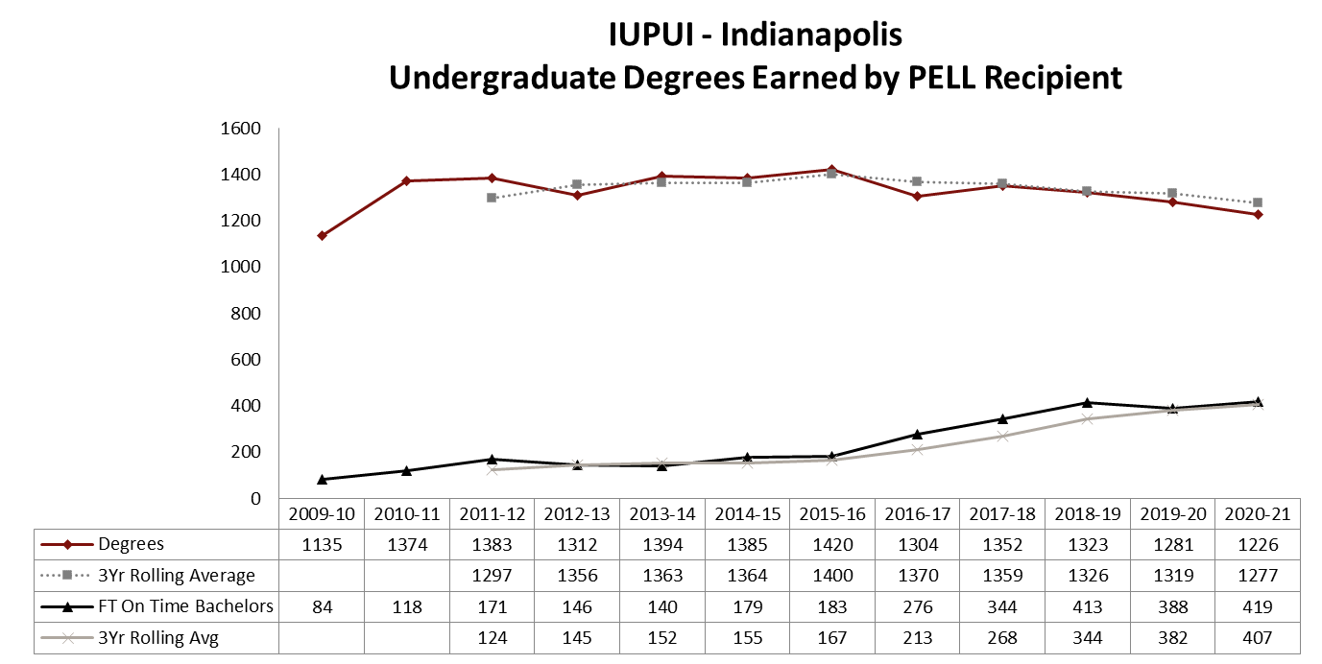
Student Performance Metrics
Indiana Resident Pell Recipients
* The “at-risk” degree completions is defined as pell recipients in the year of degree conferral.
Notes:
Updated Dec 2019

Slide 44
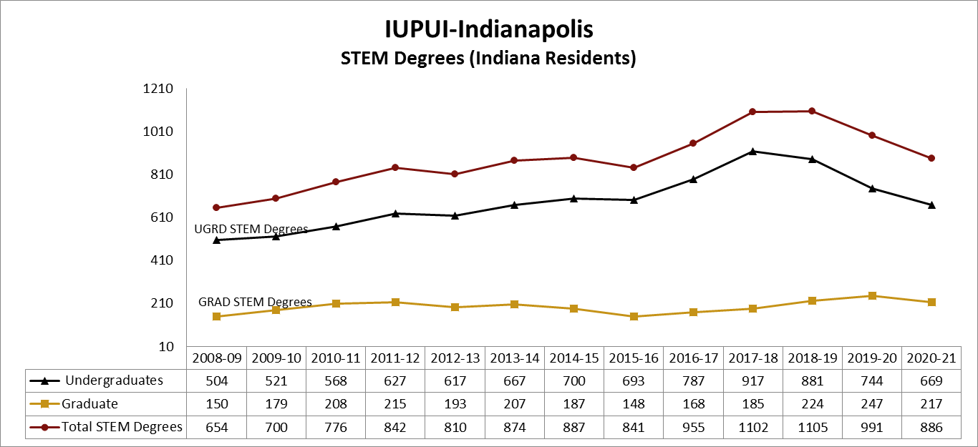
Student Performance Metrics
High Impact Degrees (STEM)
* Indiana resident students in negotiated list of high impact majors/degrees (UIRR) for performance funding.
At IUPUI this does not include degrees in School of Medicine or Dentistry.
Notes:
Updated Dec 2019
IUPUI STEM Degree List Includes:
01.1103 B.A./B.S. in Horticultural Science
03.0104 B.S. in Environmental Science
09.0702 B.S. in Human Computer Interaction
09.0702 M.S. in Human Computer Interaction
11.0101 B.S. in Computer Science
11.0101 M.S. in Computer Science
11.0101 Ph.D. in Computer Science
11.0103 B.S. in Informatics
11.0103 Ph.D. in Information Technology
11.9999 B.S. in Computer Technology
14.0101 B.S.E. in Interdisciplinary Engineering
14.0501 B.S. in Biomedical Engineering
14.0501 M.S.Bm.E. in Biomedical Engineering
14.0901 B.S. in Computer Engineering
14.1001 B.S.E.E. in Electrical Engineering
14.1001 M.S. in Electrical and Computer Engineering
14.1001 Ph.D. in Electronical, Electronics, and Communication Engineering
14.1901 B.S.M.E. in Mechanical Engineering
14.1901 M.S. in Mechanical Engineering
14.1901 Ph.D. in Mechanical Engineering
14.9999 B.S. in Energy Engineering
14.9999 B.S. in Motorsports Engineering
14.9999 M.S./M.S.E. in Interdisciplinary Engineering
15.0101 B.S. in Construction Engineering Management Technology
15.0201 B.A./B.S. in Technical Drafting
15.0303 B.S. in Electrical Engineering Technology
15.0401 B.S. in Biomedical Engineering Technology
15.0405 B.S. in Computer Integrated Manufacturing Technology
15.0899 B.S. in Mechanical Engineering Technology
15.1201 B.S. in Computer Engineering Technology
15.1303 B.A./B.S. in Architectural Technology
15.1306 B.S. in Computer Graphics Technology
15.1501 M.S. in Technology
26.0101 B.A./B.S. in Biology
26.0101 M.S. in Biology
26.0101 Ph.D. in Biology
26.1102 Ph.D. in Biostatistics
26.1103 M.S. in Bioinformatics
26.1199 M.S. in Chemical Informatics
26.1201 B.A./B.S. in Biotechnology
26.1309 Ph.D. in Epidemiology
26.1401 M.S. in Translational Science
27.0101 B.S. in Mathematics
27.0101 M.S. in Mathematics
27.0101 Ph.D. in Mathematics
30.0101 B.A./B.S. in Biological and Physical Sciences
30.1001 Ph.D. in Biopsychology
40.0501 B.A./B.S./B.S.Ch. in Chemistry
40.0501 M.S. in Chemistry
40.0501 Ph.D. in Chemistry
40.0601 B.A./B.S. in Geology
40.0601 M.S. in Geology
40.0801 B.S. in Physics
40.0801 M.S. in Physics
40.0801 Ph.D. in Physics
42.2704 Ph.D. in Clinical Psychology
43.0106 B.S. in Forensic and Investigative Science
43.0106 M.S. in Forensic Science
51.1401 M.S. in Medical Sciences
51.1401 Doctor of Medical Sciences
51.2706 M.S. in Health Informatics

Slide 45
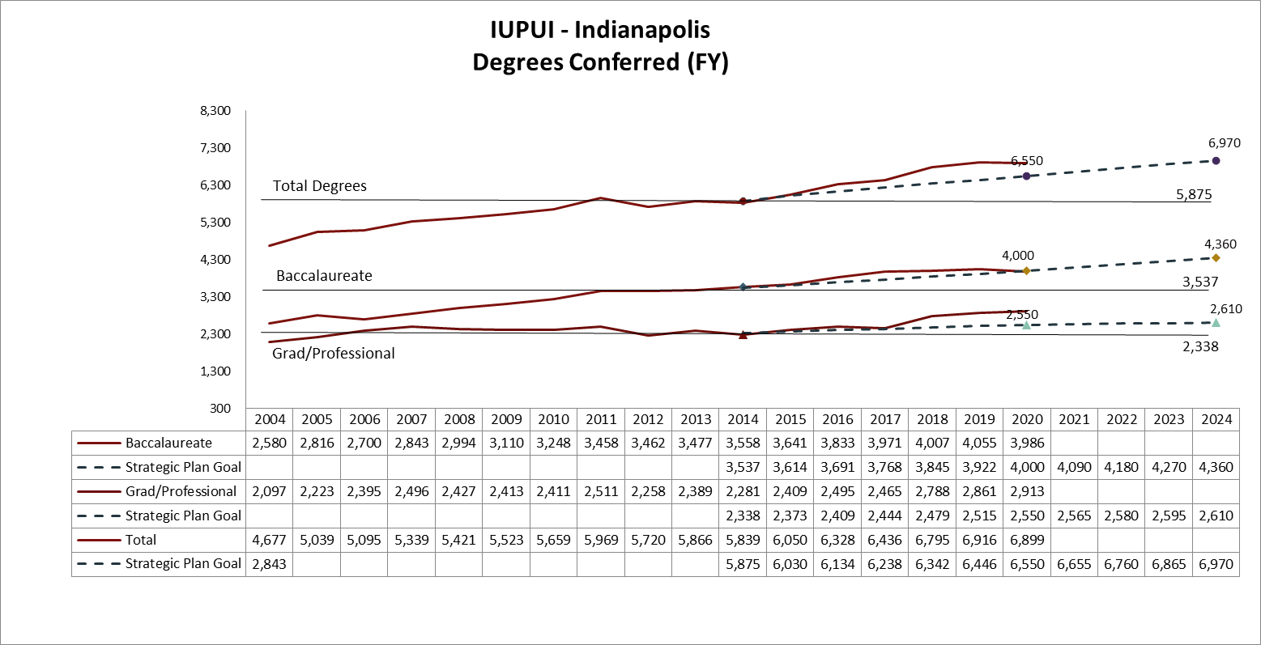
Student Performance Metrics
Degrees Conferred
*Does not include Associates or Undergradate Certificates
Notes:
Updated Dec 2019

Slide 46
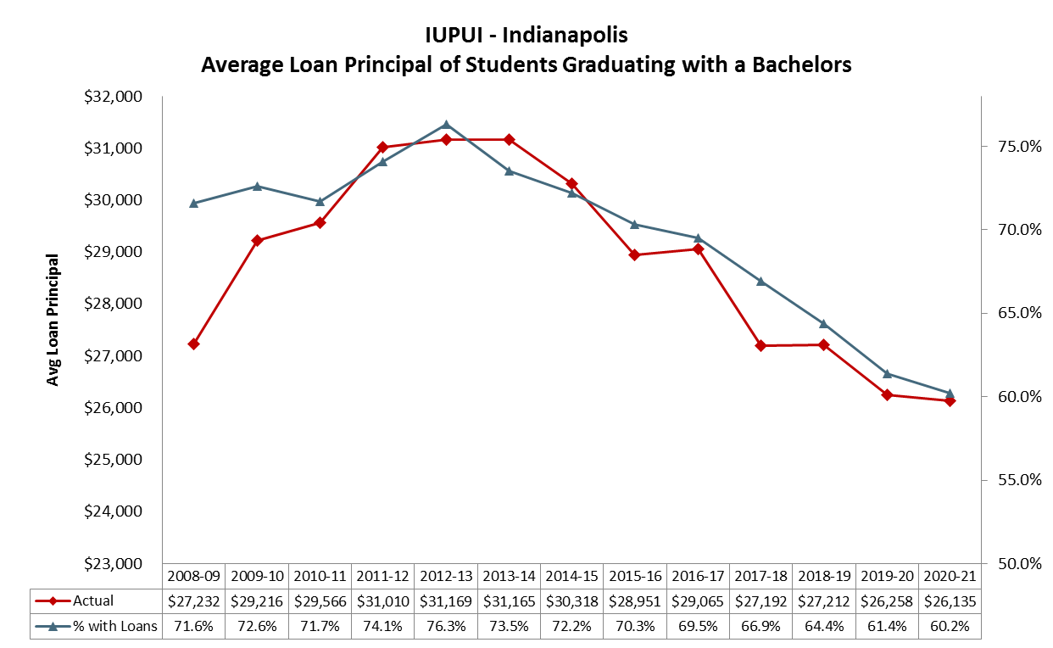
Financial Aid Metrics
Undergraduate Loan Debt
These figures include only graduates who entered IU as First-Year students and student loans from federal, IU, and private sources borrowed at IU during that program of study -- as defined by the Common Data Set (CDS).
Notes:
Updated Jan 2021

Slide 47
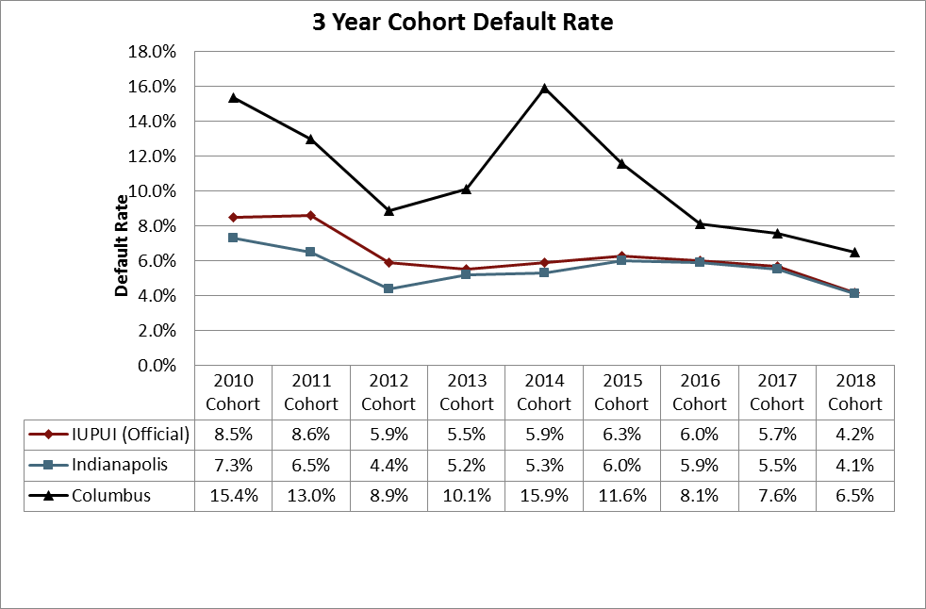
Financial Aid Metrics
Loan Default Rate
* The 2018 IUPUI Official rate is final. The Indianapolis and Columbus rates are still draft calculations.
The official default rates are now calculated on a 3-year average basis, which only goes back to the FY2010 cohort. (Prior to the FY2010 cohort, default rates were calculated on a 2-year basis and are not comparable with the current logic.)
Notes:
Updated Jan 2021

Slide 48
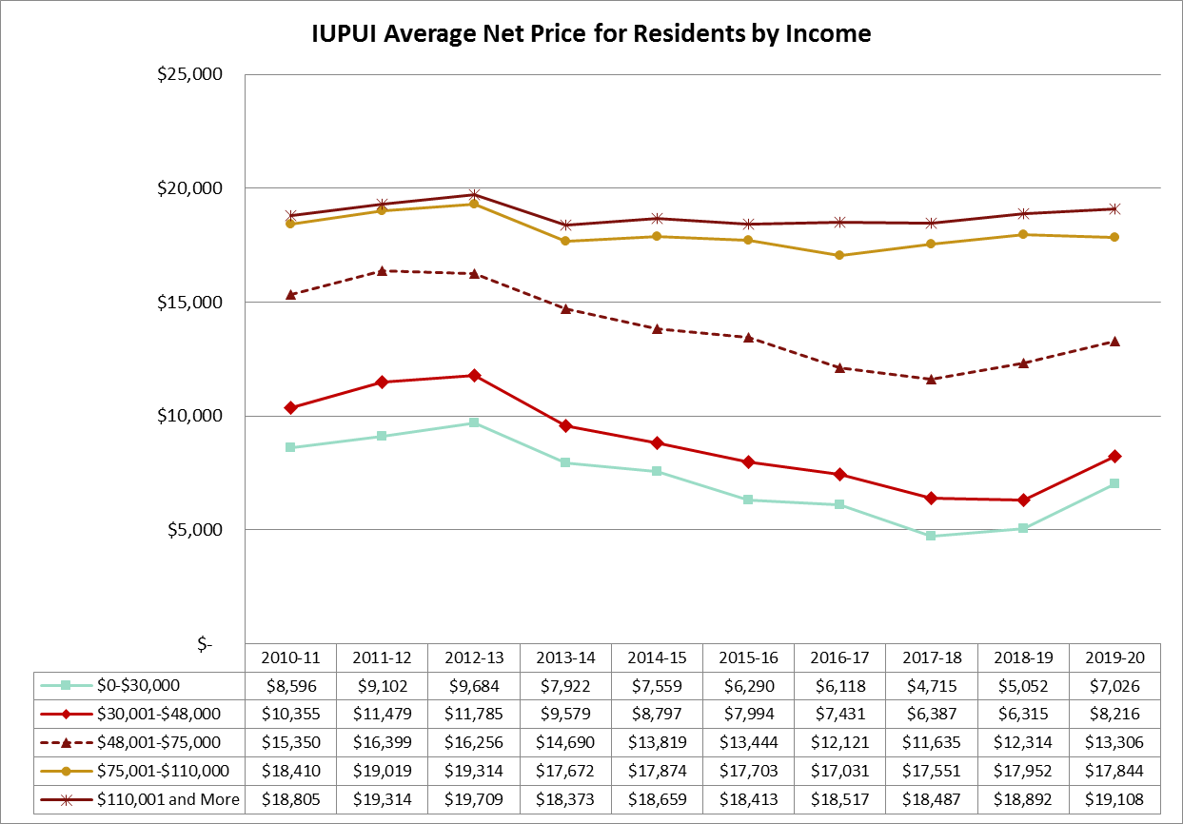
Financial Aid Metrics
Average Net Price by Income
The IPEDS net price estimates the average out-of-pocket costs for first-year, full-time undergraduates awarded gift aid (excluding private gift aid). Room and board and other non-tuition expense estimates decreased in 2013-14 by using a more moderate cost estimate methodology. Since the average net price is the difference between estimated costs like room and board and the average IPEDS gift aid, the average net changed significantly beginning in 2013-14.
Notes:
Updated Jan 2021 using uirr_tableau_ir_fa_net_price/NetPrice

Slide 49

Definition of Unmet Need
The National Common Data Set provides a framework for determining the percentage of each student’s academic year financial need that is “met” by gift aid (scholarships, fellowships, grants and fee remissions), subsidized federal student loans (loans that do not capitalize interest while students are in school), and federal work study earnings.
Unmet need is the portion of a student’s academic year financial need that exceeds these forms of financial aid.
Students may choose to borrow unsubsidized federal or private loans to cover this “unmet” portion of their financial need. This takes financial need and subtracts need based aid until it reaches zero.
This includes Stafford/Perkins subsidized loans, but not unsubsidized. This does not include parent loans or private loans. It does include military benefits.

Slide 50
Annual Unmet Financial Need and
One-Year Retention FT, FT Beginners
1,011 Fall 2020 beginners did not return to the IUPUI IN campus in Fall 2021
Notes:
Updated Jan 2021

Slide 51
Unmet Financial Need All Undergraduates Fall 2020 IUPUI – Indianapolis | N | % of All
No FAFSA on file | 5084 | 27.8%
No Unmet Financial Aid Need (FAFSA on file) | 4474 | 24.4%
$1 - $1000 Unmet Need | 739 | 4.0%
$1001 to $2000 unmet need | 629 | 3.4%
$2001 to $3000 unmet need | 785 | 4.3%
$3001 to $4000 unmet need | 736 | 4.0%
$4001 to $5000 unmet need | 674 | 3.7%
$5001 to $6000 unmet need | 714 | 3.9%
$6001 to $7000 unmet need | 648 | 3.5%
$7001 to $8000 unmet need | 553 | 3.0%
$8001 to $9000 unmet need | 475 | 2.6%
$9001 to $10000 unmet need | 416 | 2.3%
More than $10,000 Unmet Need | 2376 | 13.0%
Grand Total | 18303
*4,468 with unmet financial need levels over $6,000
Notes:
Updated Jan 2021

Slide 52
Unmet Financial Need Annual Fall 2020 IUPUI Indianapolis Full-Time Beginners | N | One-Year Retention Rate at IUPUI | One-Year GPA
No FAFSA on file | 259 | 64.1% | 2.33
No Unmet Financial Aid Need (FAFSA on file) | 1219 | 77.3% | 2.88
$0 to $3000 | 559 | 63.0% | 2.38
$3001 to $6000 | 532 | 64.5% | 2.29
$6001 to $9000 | 297 | 62.0% | 2.14
$9001 to $12000 | 151 | 57.6% | 1.79
> $12,000 Unmet Need | 156 | 64.1% | 2.51
Grand Total | 3173 | 68.5% | 2.51
*604 beginners with unmet financial need over $6,000
Notes:
Updated Jan 2021 – use SQL unmet need GPA

Slide 53
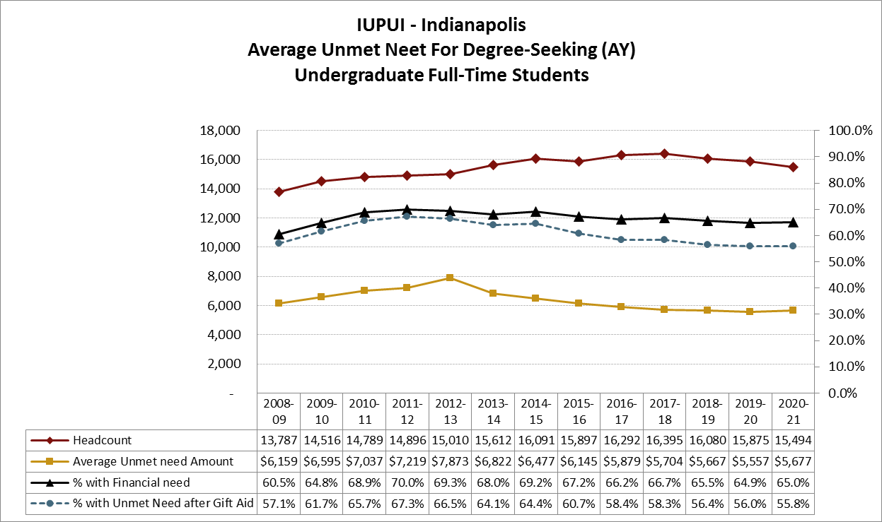
Financial Aid Metrics
Unmet Need of Undergraduate Degree Seekers
Unmet need as defined in the Common Data Set (CDS) for degree-seeking undergraduates enrolled at fall census is an average (mean) for the academic year (fall+spring). The CDS limits its unmet need figures to students with both need and aid.

Slide 54
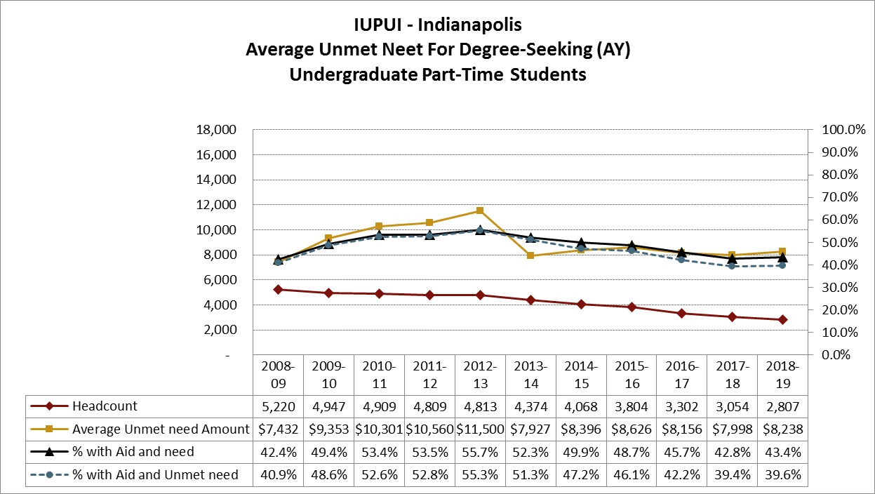
Financial Aid Metrics
Unmet Need of Undergraduate Degree Seekers
Unmet need as defined in the Common Data Set (CDS) for degree-seeking undergraduates enrolled at fall census is an average (mean) for the academic year (fall+spring). The CDS limits its unmet need figures to students with both need and aid.
Notes:
Updated Oct 3, 2018

Slide 55
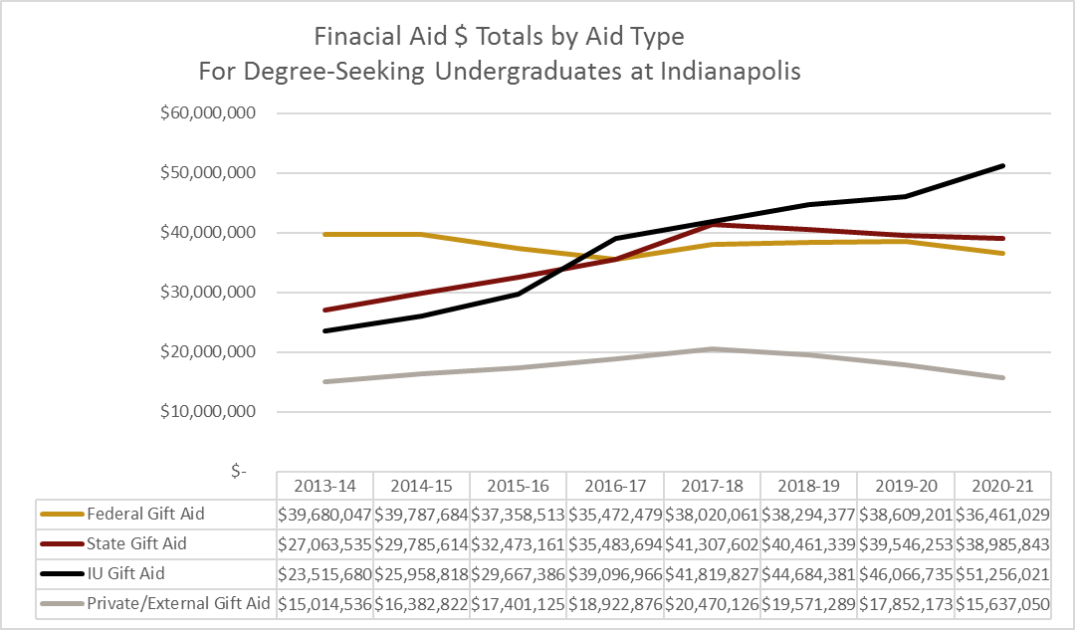
Financial Aid Metrics
Aid Awarded to Undergraduate Degree Seekers
Notes:
Updated Jan 2021

Slide 56
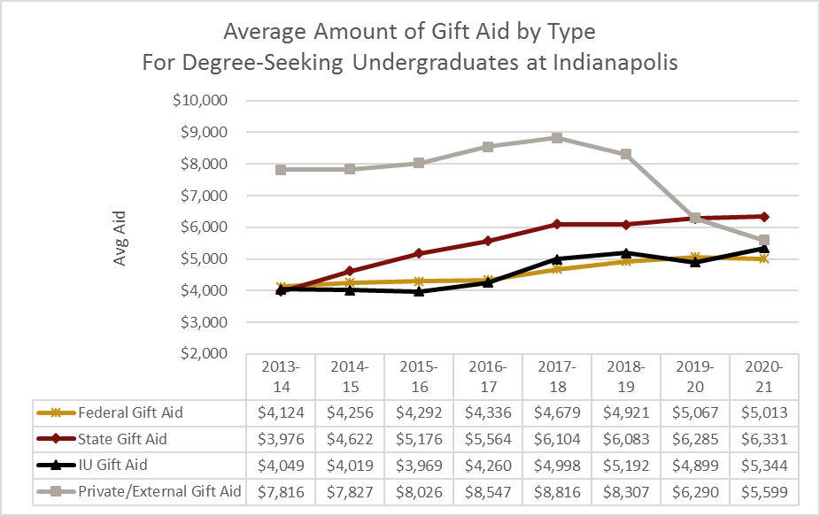
Financial Aid Metrics
Aid Awarded to Undergraduate Degree Seekers
Notes:
Updated Dec 2019

Slide 57
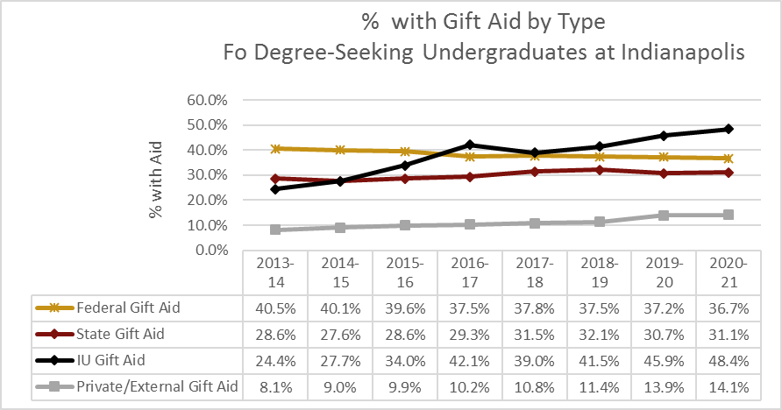
Financial Aid Metrics
Aid Awarded to Undergraduate Degree Seekers
Notes:
Updated Jan 2021

Slide 58
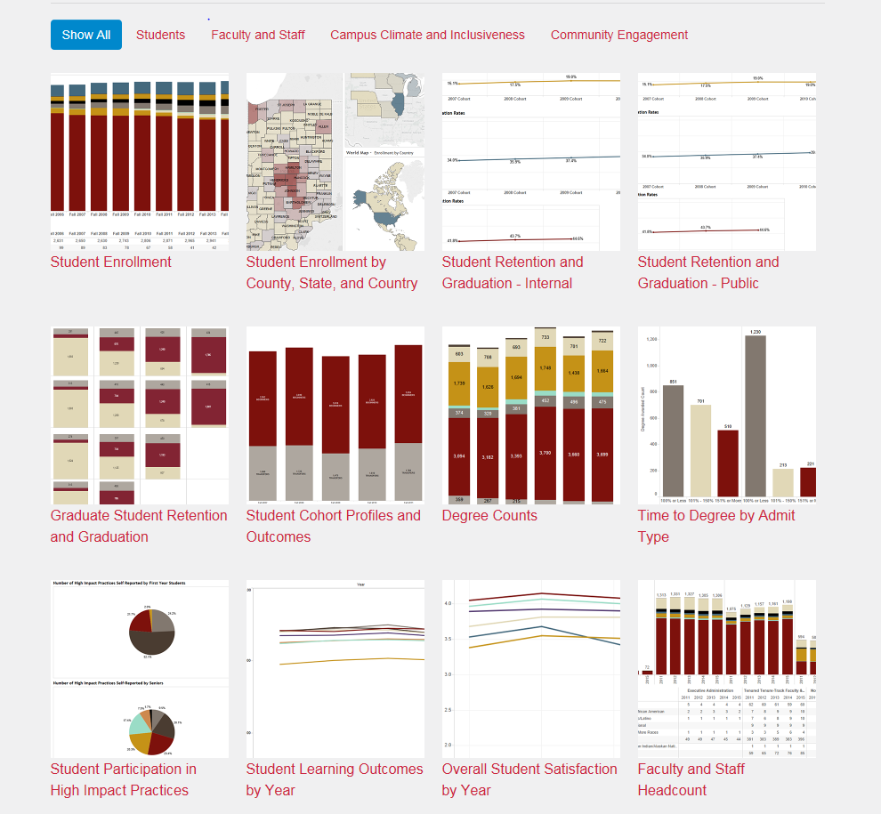
Strategic Plan Data Link Reports
More Information available here
(Including IUPUI Indianapolis and Columbus):
IUPUI Data Link
Institutional Research and Decision Support
irds.iupui.edu
Contact us with questions or requests for information!

